Slide 1
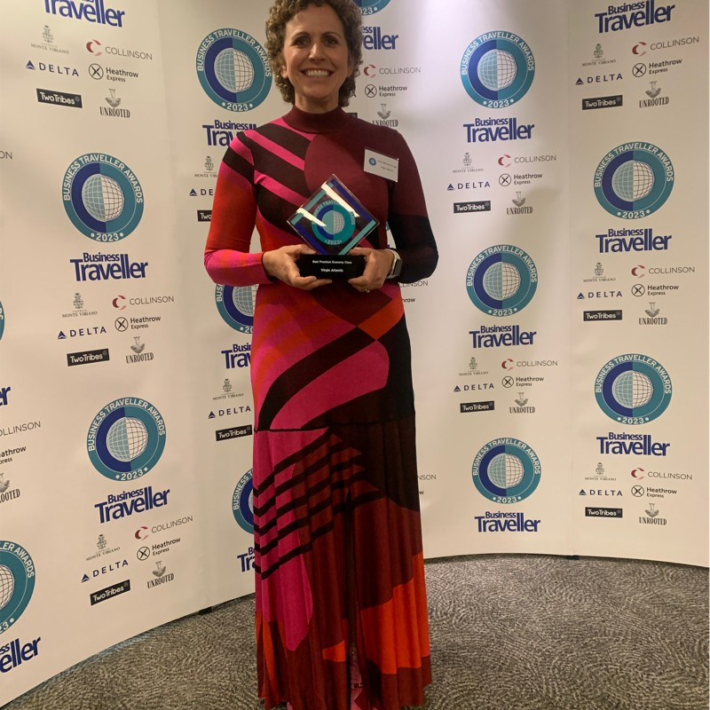
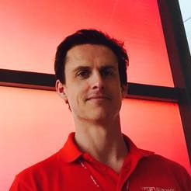
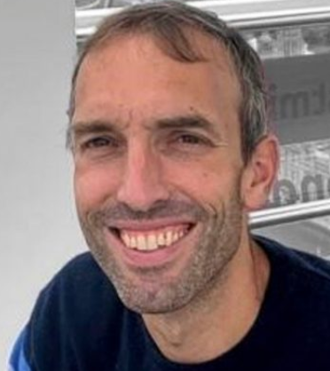
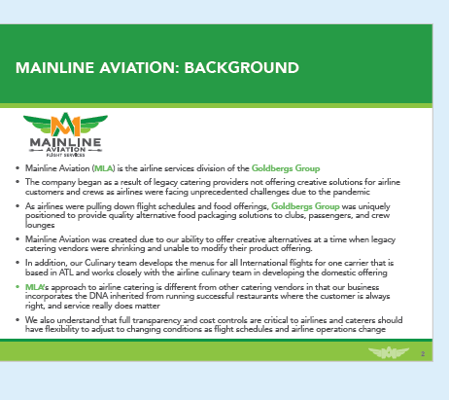
Virgin Atlantic Catering RFP
Meeting Details
Virgin Headquarters: Fleming Way Crawley, West Sussex
Presentation Time: Your presentation is confirmed for 2pm - 4pm.
Leave by 12:15
Dave Geer– SVP Operations (7 yr)
Julie Dilloway-Knapp–VP Cabin
Paul Mills– Head of Inflight Services
Kelly Patsavas – Sr Mgr Catering Operations
Paola Calderon - Sr Mgr Catering Operations
Audrey Ceccaldi– Senior Manager Food, beverage and Ancillaries
Miles King- Senior Manager Customer Journeys
Connor Genders- Manager Inflight Services
Julie Dilloway-Knapp: VP cabin
25 yrs at VA
Recently transitioned in past year to Cabin and IFS
Paul Mills: Head of IFS
10 yrs with VA
Deloitte prior
Speaker at IFSA this year
Dave Geer
SVP Ops
7 yrs with VA
Slide Talking Points
Speaker: Steve
Kick off Meeting with round of introductions
Background; history of Mainline
Our advantages and approach
With our history of Airline Procurement experience we provide ourselves with bringing full transparency
2

Slide 2
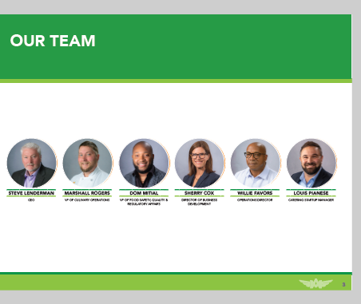

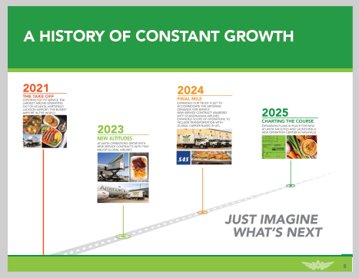
Speaker: Sherry
Introduce team that is not present
Speaker: Sherry
Introduce Strategic Partners- sister company Mainline foods which is our food manufacturer, in house microbiology testing partner and our partner brands
Speaker: Steve
Through the years highlighting major milestones
Launch year to 2025 growth

Slide 3



Speaker: Sherry
Proud slide moment making steps to a sustainable future through small steps in our operation with our recycled cardboard program.
Our partnership with a Domestic airline on meals donations
Refugee hiring program
As well as many more local charitable initiatives
Which leads me into the next slide
We have been nominated as host hero through GA restaurants association. Goldbergs group include our restaurants, catering, and manufacturing

Slide 4
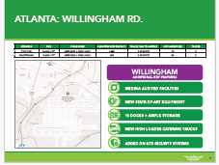
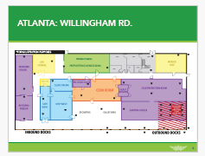
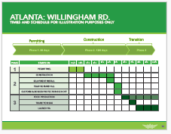
Speaker: Steve
Comparing the location of our 2 sites both within 5 mins from airport\Sullivan currently supports SAS, Ethopian and American- we will be moving SAS out and into Willingham in which will share the space with VA
Key highlights; Medina audited facility, new state of the art production equipment,
Speaker: Steve
Lets take a tour- starting in receiving area- highlight # of docks
End with security area that will be sectioned off for 100% cart checks from security provider
VA will also have 2 dedicated refrigerated trucks to support operation which will be arriving this week
Speaker: Steve
Once we receive award, we will break ground on the construction and remodel,
3 Phase approach with transitioning SAS first and then moving in VA, expected launch timing is Sept

Slide 5
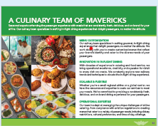
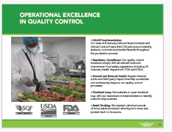

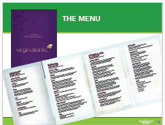
Speaker: Chef
Core areas of responsibility
Speaker: Chef
Wanted to highlight our QA team that focuses on food safety
Speaker: Chef
For those that couldn’t be apart of the tasting. We hosted the team to want through our menu
Wanted to highlight some of the following

